Slide 1
Intel College Excellence Program
Data Analytics
“If you torture the data long enough, it will confess.”- Ronald Coase, Economist

Slide 2
What is Data Science
By definition:
Data Science is the
exploration and quantitative analysis
of all available
structured and unstructured data
to
develop understanding, extract knowledge,
and
formulate actionable results.

Slide 3
…….So what does data science enable
Transition from
Intuition to Data Driven Analytical Decisions
Transform
Raw Data to Valuable Asset
Take
Preventive, Predictive & Prescriptive Actions

Slide 4
Motivation
The relevant data stats agree that there should be around 175 zettabytes of data by 2025. It’s a number that’s hard to envision!
1 ZB = 1000⁷bytes = 10²¹byte

Slide 5
Definitions
Data Science
Dealing with structured and unstructured data
Everything related data cleaning, process and analysis
Data Science
Data Analysis
Data Analytics
Data Mining
Data Analysis
Detailed examination of the elements or structure of something
Data Analytics
Principle or logic that drives the analysis
Using statistics, with or without the aid of computerized tools, to analyze data.
Tools
Computations
Statistics
Data Mining
Predictive
ML algorithms

Slide 6
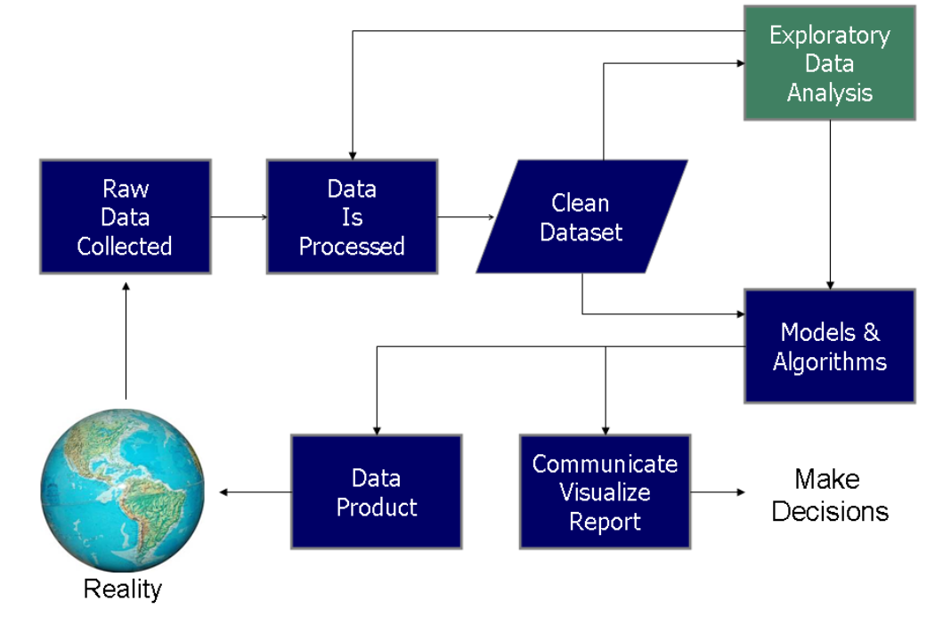
Data Science Process
Define business need, requirement
Data science process flowchart from Doing Data Science, by Schutt & O'Neil (2013)
Notes:
Data requirements
The data are necessary as inputs to the analysis, which is specified based upon the requirements of those directing the analysis or customers (who will use the finished product of the analysis). The general type of entity upon which the data will be collected is referred to as an experimental unit (e.g., a person or population of people). Specific variables regarding a population (e.g., age and income) may be specified and obtained. Data may be numerical or categorical (i.e., a text label for numbers)
Data collection
Data are collected from a variety of sources. The requirements may be communicated by analysts to custodians of the data, such as information technology personnel within an organization. The data may also be collected from sensors in the environment, such as traffic cameras, satellites, recording devices, etc. It may also be obtained through interviews, downloads from online sources, or reading documentation.
Data processing
The phases of the intelligence cycle used to convert raw information into actionable intelligence or knowledge are conceptually similar to the phases in data analysis. Data initially obtained must be processed or organised for analysis. For instance, these may involve placing data into rows and columns in a table format (i.e., structured data) for further analysis, such as within a spreadsheet or statistical software.
Data cleaning
Once processed and organised, the data may be incomplete, contain duplicates, or contain errors. The need for data cleaning will arise from problems in the way that data are entered and stored. Data cleaning is the process of preventing and correcting these errors. Common tasks include record matching, identifying inaccuracy of data, overall quality of existing data,[6] deduplication, and column segmentation.
Exploratory data analysis
Once the data are cleaned, it can be analyzed. Analysts may apply a variety of techniques referred to as exploratory data analysis to begin understanding the messages contained in the data. The process of exploration may result in additional data cleaning or additional requests for data, so these activities may be iterative in nature. Descriptive statistics, such as the average or median, may be generated to help understand the data. Data visualization may also be used to examine the data in graphical format, to obtain additional insight regarding the messages within the data.
Modeling and algorithms
Mathematical formulas or models called algorithms may be applied to the data to identify relationships among the variables, such as correlation or causation. In general terms, models may be developed to evaluate a particular variable in the data based on other variable(s) in the data, with some residual error depending on model accuracy (i.e., Data = Model + Error).
Inferential statistics includes techniques to measure relationships between particular variables. For example, regression analysis may be used to model whether a change in advertising (independent variable X) explains the variation in sales (dependent variable Y). In mathematical terms, Y (sales) is a function of X (advertising). It may be described as Y = aX + b + error, where the model is designed such that a and b minimize the error when the model predicts Y for a given range of values of X. Analysts may attempt to build models that are descriptive of the data to simplify analysis and communicate results.

Slide 7
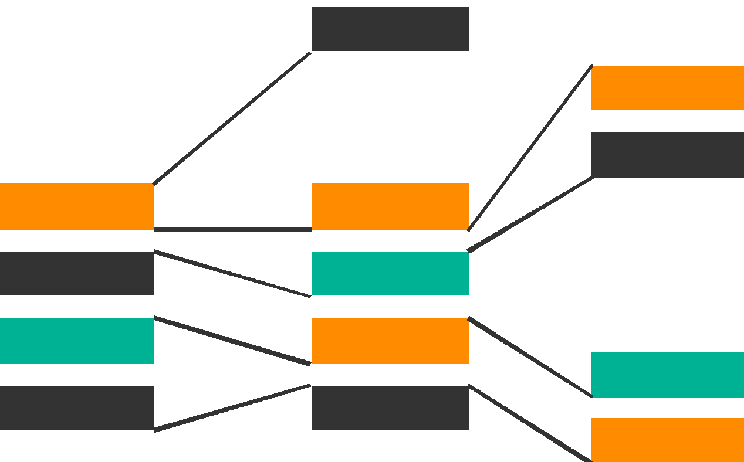
Knowledge Discovery in Databases -KDD process
searching for patterns of interest in a representational form or a set of such representations, including classification rules or trees, regression, and clustering.
Interpretation / Evaluation
Finding useful Feature to extract data as per target; matching the goals of the KDD process (step 1) to a data-mining method
Data Mining
Transformation
Preprocessing
Information
Patterns
Selection
Transformed Data
*CCC had no citations to KDD
Preprocessed Data
Data
Target Data
Based on content in “From Data Mining to Knowledge Discovery”, AI Magazine, Vol 17, No. 3 (1996)
http://www.aaai.org/ojs/index.php/aimagazine/article/view/1230
Notes:
Way before the CCC had “big data” as a twinkling in their eyes. And the CCC people did not cite the original KDD paper – they didn’t know about each other. Perhaps there is something fundamental here about this process. Maybe it’s like an important number, like pi or the golden ratio or something. This sort of universal process that people separately discover. Anyway, so this is the kdd process.

Slide 8
Types of Data Analytics
Value
Descriptive Analytics: What is happening?
Comprehensive, accurate and live data
Effective visualization
Diagnostic Analytics: Why is it happening?
Drill down the root cause
Isolate the confounding information
Predictive Analytics: What is likely to happen?
Likelihood of an event happening in future
Estimating a point in time at which something might happen
Prescriptive Analytics: What do I need to do?
Recommended actions and strategies based upon the challenges
Applying advanced analytical technique
Google maps suggesting best route home
Prescriptive
Predictive
Diagnostic
Descriptive
Complexity

Slide 9
Data Analysis & Modelling – Understand data relationship
Probability
“Probability” measures the likelihood of a random variable to take on a specified range of outcomes.
Statistical modelling tools to get meaning out of data
Average, Median
Standard Deviation
Regression
Correlation
Covariance

Slide 10
Model Building
Often predictive modeling, meaning machine learning or statistical modeling
If you want to answer a yes/no question, this is classification.
For manholes, will the manhole explode next year? Y/N
If you want to predict a numerical value, this is regression.
Ex: Stock prediction at BSE Sensex tomorrow ?
If you want to group observations into similar-looking groups, this is clustering.
If you want to recommend someone an item (e.g., book/movie/product) based on ratings data from customers, this is a recommender system.
Note: There are many other machine learning problems.

Slide 11
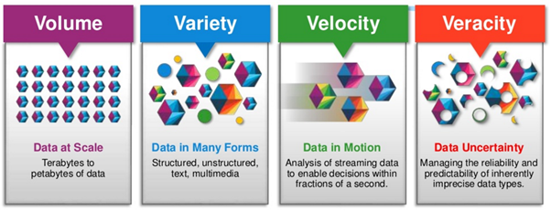
Data Sources- Identify, Select & Acquire
Data sources
Identify - sensors, images, videos, audio
Connect, Acquire and aggregate data
4 V’s of Big Data

Slide 12
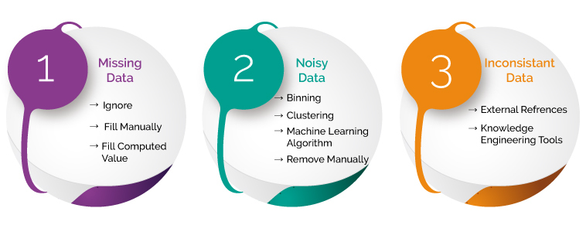
Pre-processing, Cleansing, Transforming
Importance of data cleansing and pre-processing GARBAGE IN GARBAGE OUT

Slide 13
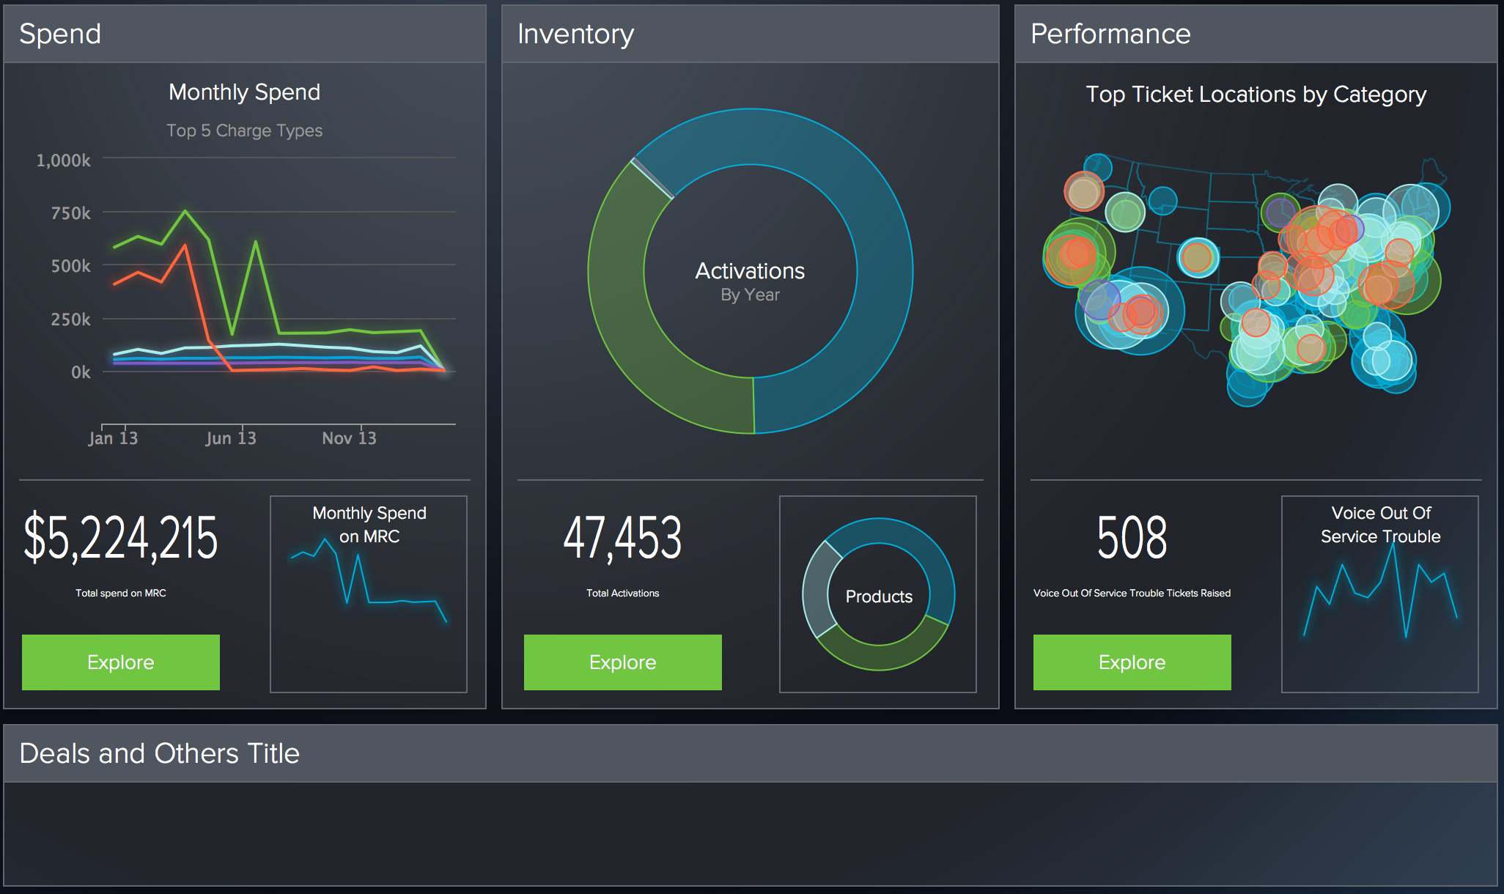
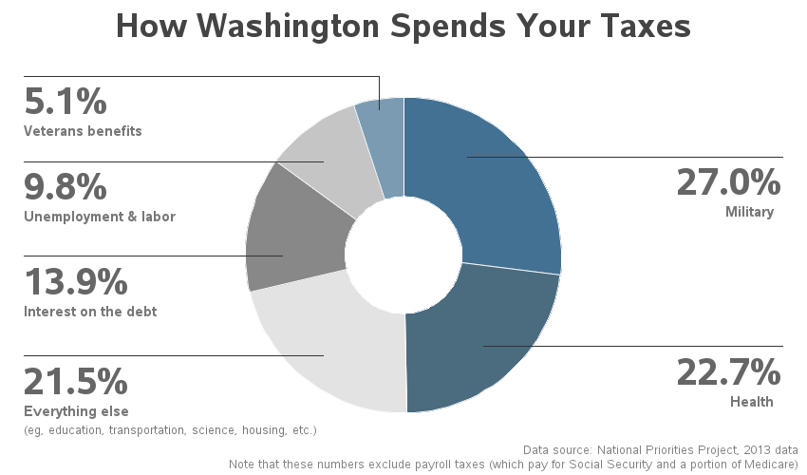
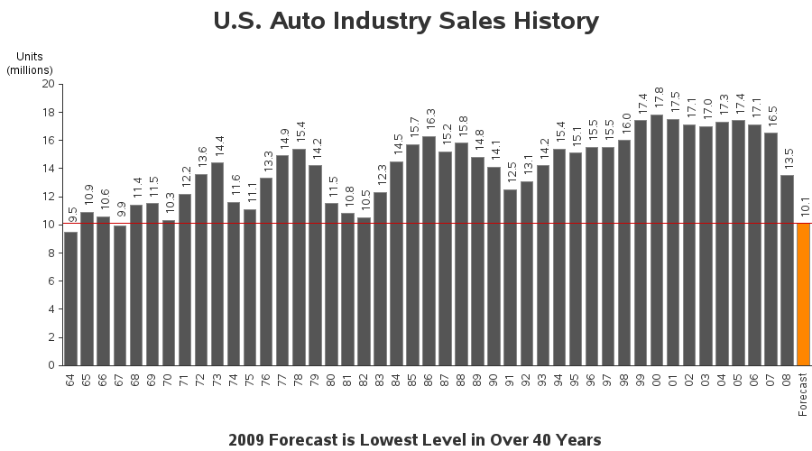
Data Visualization
Data Visualization enables Interpretation & Inference

Slide 14
Data Analytics Open-Source Tools
Many popular Data Analytics Tools available which can handle data and help to infer useful information from given dataset:
Out of numerous open-source tools available, popular Data Analytics Tools which we are going to use in our workshop are:
Numpy – Numerical Python
Pandas – Data Frame
Matplotlib – Visualization

Slide 15

Please contact
Foundation for Innovation and Collaborative
Education
mentor@fice.in
www.fice.in
Please contact
Foundation for Innovation and Collaborative
Education
info@fice.in
mentor@fice.in
Notes:
Here are the lessons we are going to learn today.

